Slide 1
how old would you be if you didn’t know how old you were?

Slide 2
Esri’s Young Professionals
Lighting Panel
Courtney Claessens
John Fry
Sarah Schwoppe
John Dombzalski
Moderated by Jon Bowen

Slide 3
this is mean to be informal so drum up some good questions about speakers, esri, or GIS as a whole and we’ll address them afterwards.
first off

Slide 4
don’t be intimidated by the giant.

Slide 5
don’t be intimidated by the giant.
enterprise

Slide 6
don’t be intimidated by the giant.
corporate

Slide 7
don’t be intimidated by the giant.
non-open source

Slide 8
don’t be intimidated by the giant.
global leader

Slide 9
don’t be intimidated by the giant.
product engineer

Slide 10
don’t be intimidated by the giant.
solutions engineer

Slide 11
don’t be intimidated by the giant.
product manager

Slide 12
don’t be intimidated by the giant.
because it’s actually pretty awesome

Slide 13

don’t be intimidated by the giant.
because it’s actually pretty awesome

Slide 14
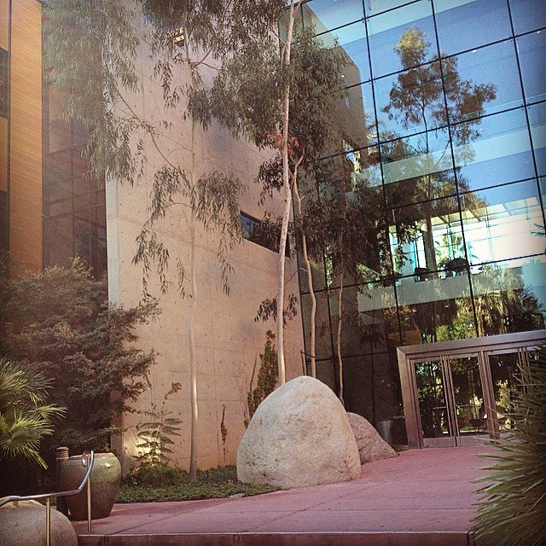
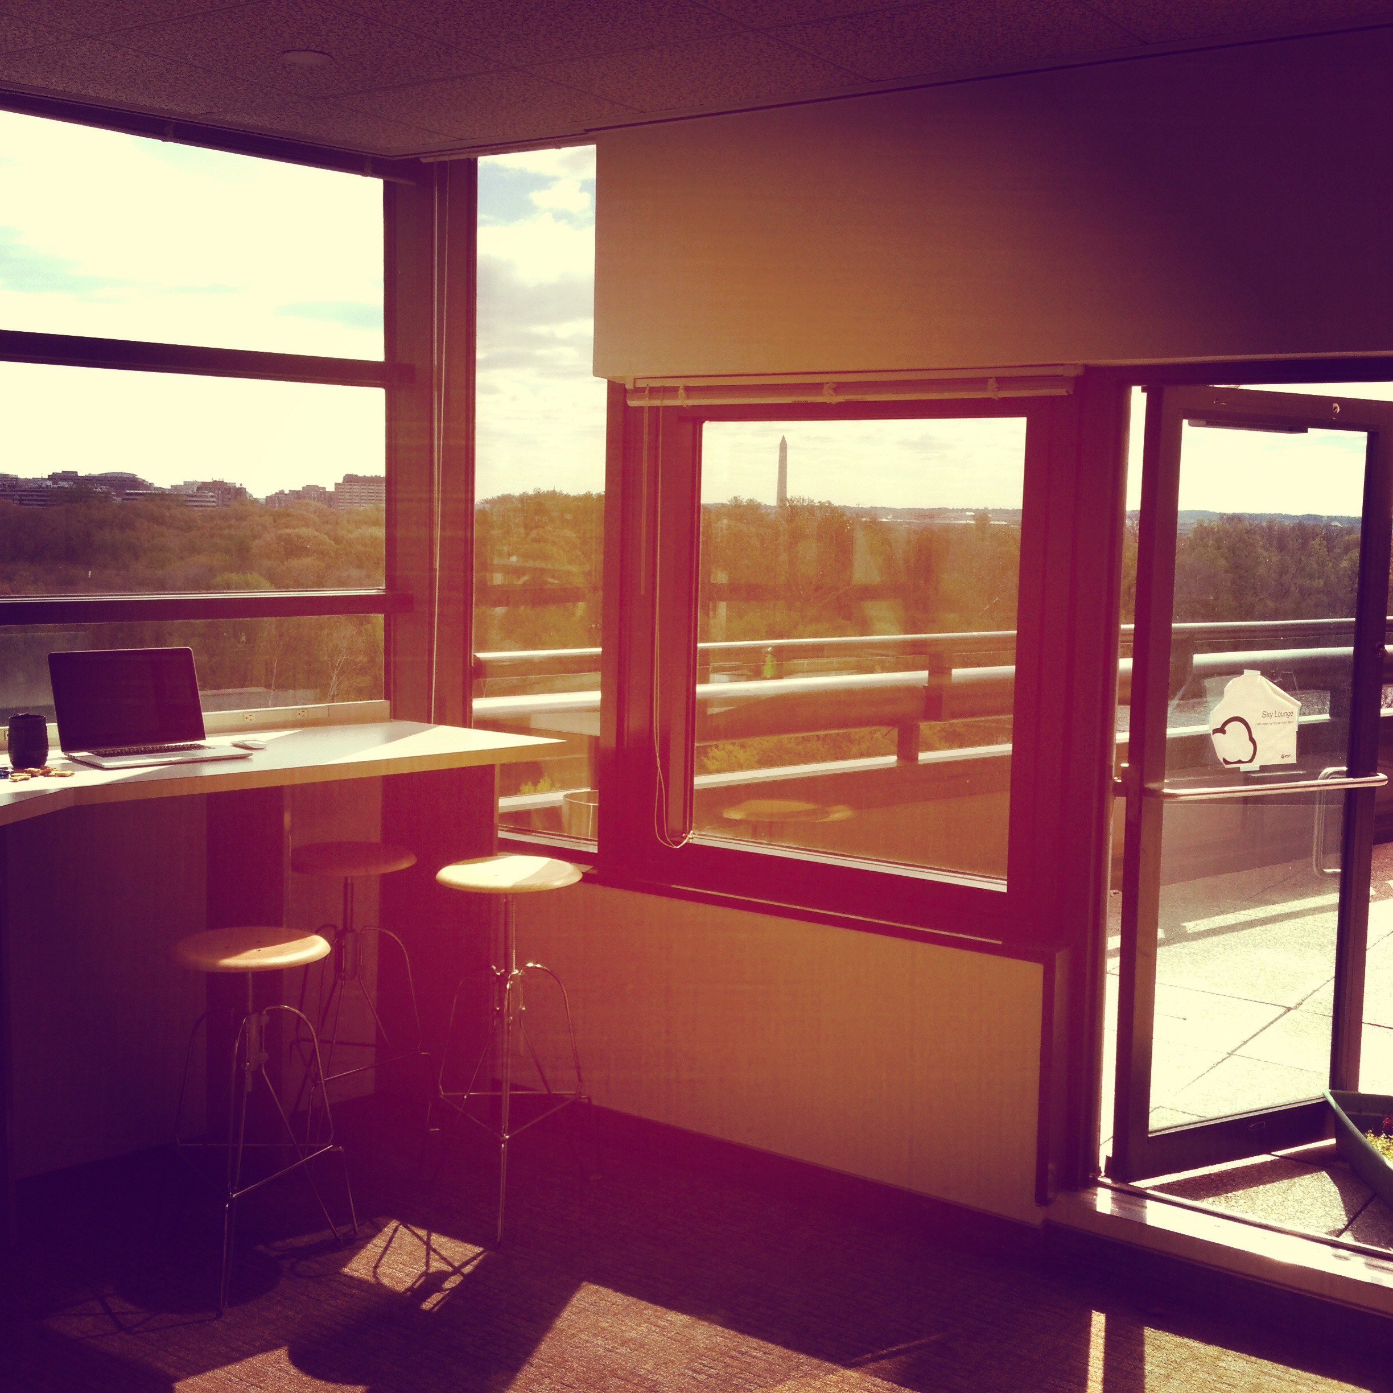
don’t be intimidated by the giant.
because it’s actually pretty awesome

Slide 15
creative
making new products or current products better

Slide 16
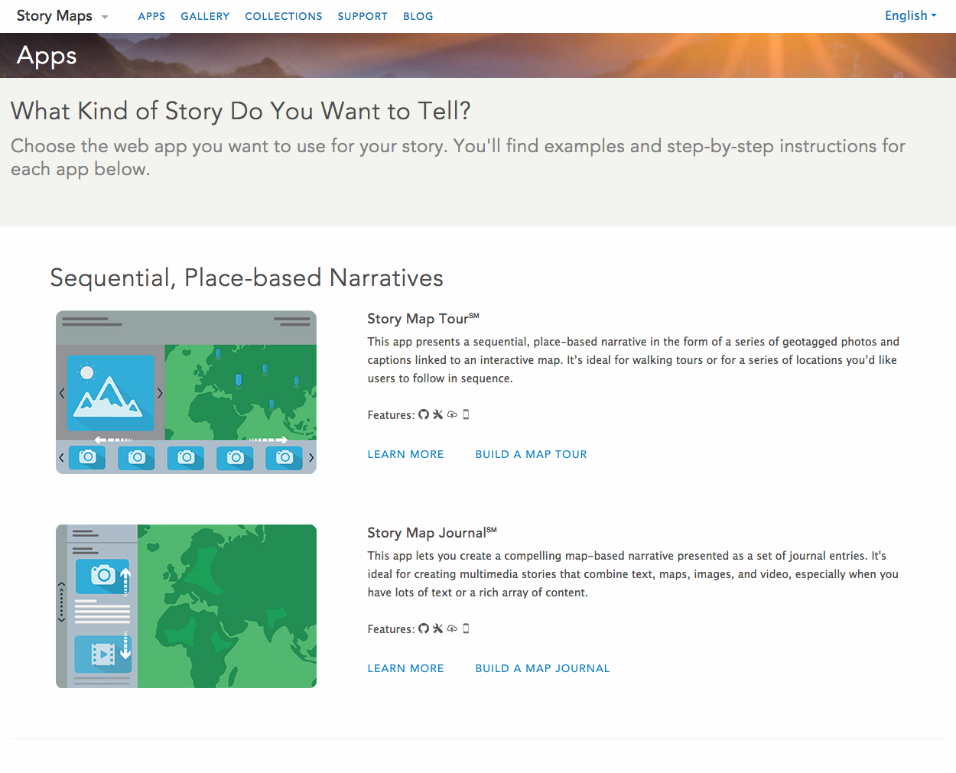
creative
making new products or current products better

Slide 17













global solutions to global problems
implementing effective change to multiple cities and multiple policies

Slide 18
established user community
opportunities over barriers

Slide 19


Slide 20
John Fry
Solutions Engineer, DC Tech Support

Slide 21
Courtney Claessens
Product Engineer/Community Development for ArcGIS Open Data

Slide 22
John Dombzalski
Account Manager for the Federal Government

Slide 23
Sarah Schwoppe
Solutions Engineer, DC Tech Support

